Slide 1
Bulk Payments Enhancements: Roadmap
Paul Makin
PI-18 OSS Community Meeting

Slide 2
The Problems
As currently implemented, the Mojaloop Bulk Payment service operates in a manner that doesn’t match market expectations
Payers just want to hand over a list; Mojaloop wants a series of sorted lists, one per payee DFSP
Payee DFSPs vary in their capabilities; some can accept a bulk payments list, others cannot

Slide 3
Short Term Solution
Accept a bulk payments list from a DFSP, and deal with them as though they’re individual transactions:
Process them one by one (discover, agree, transfer)
Assemble a single bulk transfer response and return it to the sender
Pros:
Simple, straightforward to implement
Supports some DFSPs’ inability to accept bulk lists
Cons:
Increased load on the Hub
Only suitable for relatively short lists; good for loan disbursements, not good for ECT
Notes:
Pros:
Simple, straightforward to implement
Cons:
Increased load on the Hub
Only suitable for relatively short lists; good for loan disbursements, not good for ECT

Slide 4
Medium Term Solution
Accept a bulk payments list from a DFSP, and sort it into individual lists (one per payee DFSP):
Process each list as a Mojaloop Bulk Payment
For some Payee DFSPs, it will be necessary to break up the list at the “receive” end and process as individual transactions
Assemble a single bulk transfer response and return it to the sender
Pros:
Allows us to reach scale
Supports some DFSPs’ inability to accept bulk lists
Cons:
More complex to implement; longer lead time
Notes:
Pros:
Simple, straightforward to implement
Cons:
Increased load on the Hub
Only suitable for relatively short lists; good for loan disbursements, not good for ECT

Slide 5
Route to Implementation of the Short Term Solution
This is a core use case for WynePay, so the STS has been fast tracked
WynePay uses Payment Manager to connect DFSPs, which gives us a route to implementation: using Payment Manager for orchestration of bulk payments
Payment Manager
DFSP
Core Connector
Mojaloop Connector
Mojaloop
Other Stuff

Slide 6
Route to Implementation of the Short Term Solution
Payment Manager
Core Connector
Mojaloop Connector
Specific to WynePay
OSS Implementation
Other Stuff

Slide 7
Route to Implementation of the Short Term Solution
Payment Manager
Core Connector
Mojaloop Connector
Specific to WynePay
OSS Implementation
Routing:
“Wallet shortcode, MSISDN”
Other Stuff

Slide 8
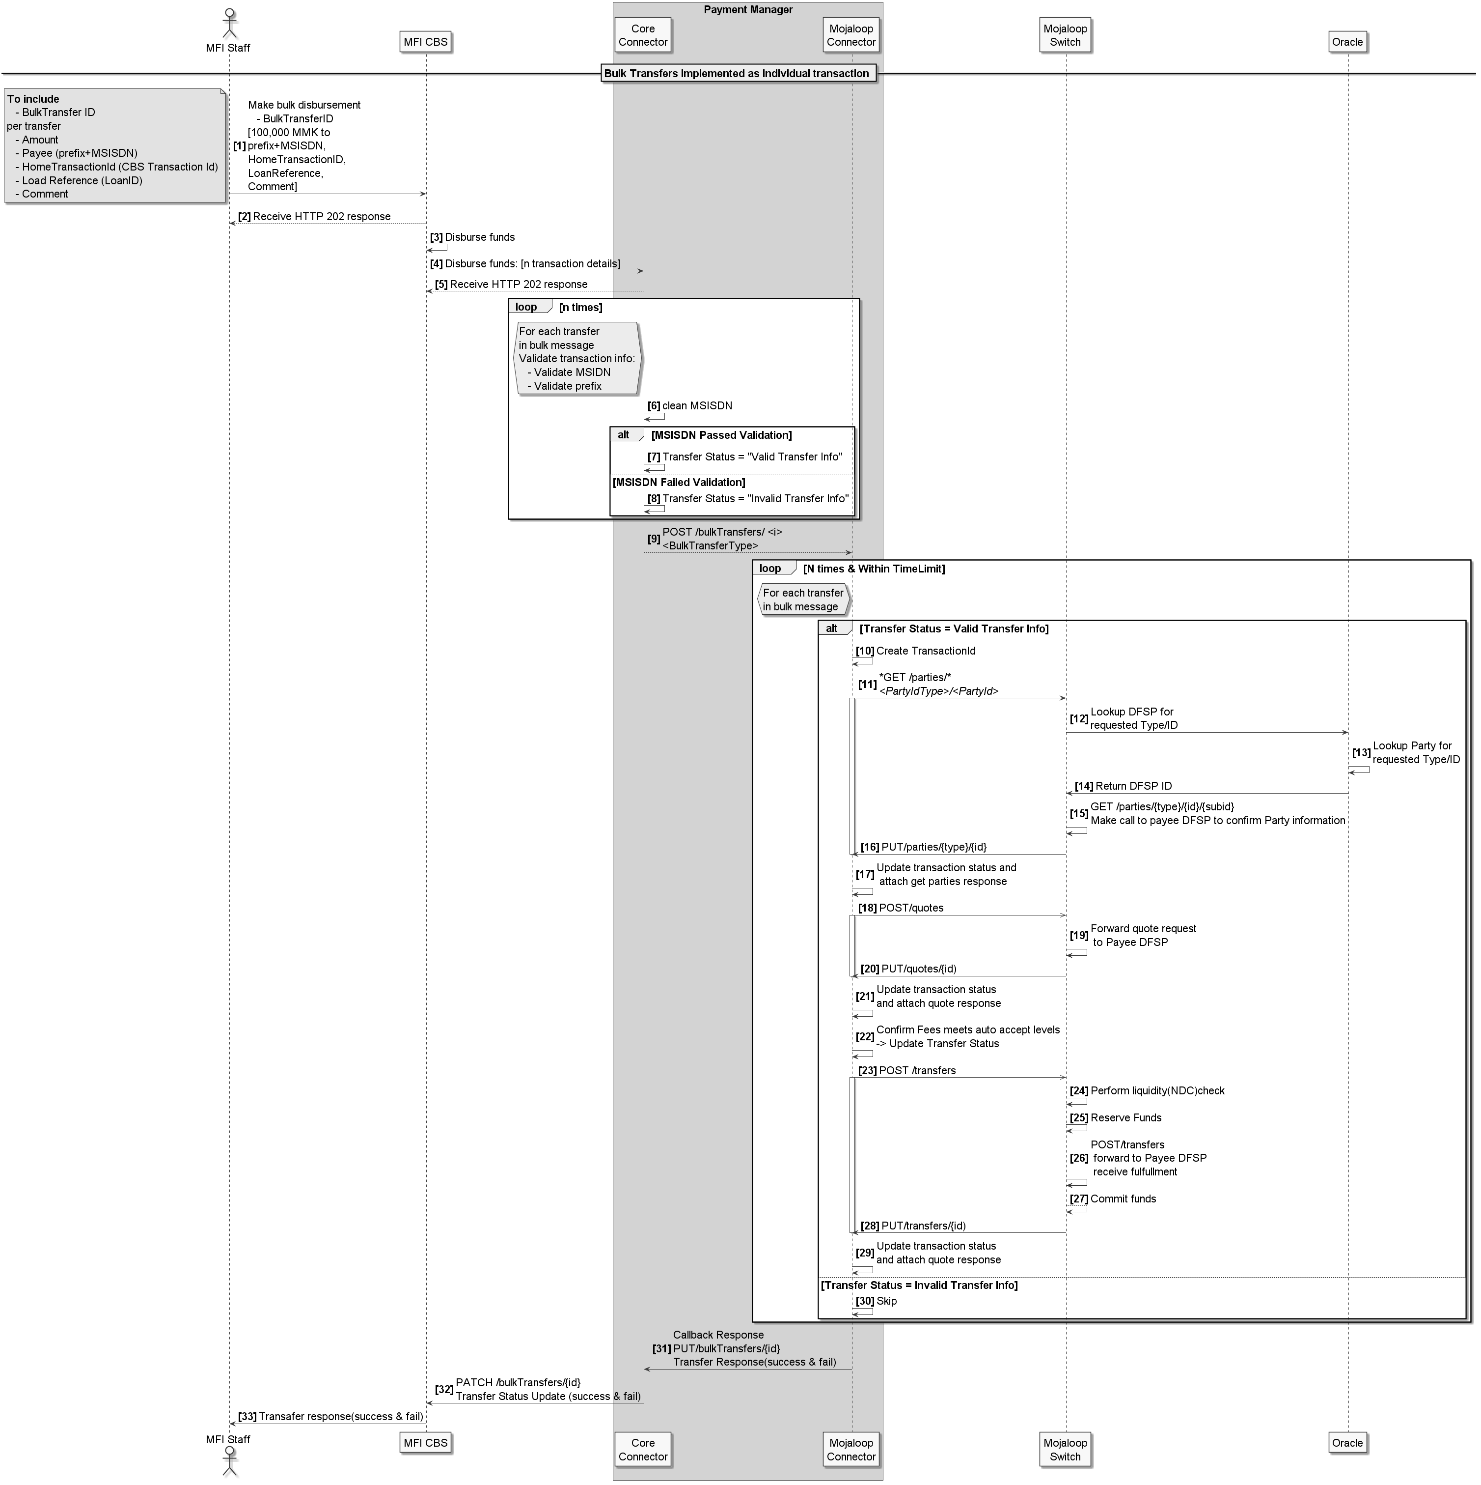
Process Flow

Slide 9
Process Flow

Slide 10
Process Flow: Core Connector

Slide 11
Process Flow: Mojaloop Connector

Slide 12
Progress
We have a design; it’s been reviewed by the dev teams, and all of the user stories have been documented
Sized, acceptance criteria defined, tests defined, etc.
Implementation has begun, and will be completed this PI
Notes:
Pros:
Simple, straightforward to implement
Cons:
Increased load on the Hub
Only suitable for relatively short lists; good for loan disbursements, not good for ECT

Slide 13
Progress
We have a design; it’s been reviewed by the dev teams, and all of the user stories have been documented
Sized, acceptance criteria defined, tests defined, etc.
Implementation has begun, and will be completed this PI
Unanticipated Bonus:
During the design process, it became clear that the most straightforward route to implementation included the upgrade of the oracle to support P2P transactions
Notes:
Pros:
Simple, straightforward to implement
Cons:
Increased load on the Hub
Only suitable for relatively short lists; good for loan disbursements, not good for ECT

Slide 14
Thank you!
Comments/Questions?

